Slide 1
INTRODUCTION TO
Inherited Cancer Genetic Counselling, cBioportal, COSMIC and Somatic Clinvar
Jan 11 2025
Giảng viên: TS. Lưu Phúc Lợi
Email: Luu.p.loi@googlemail.com
Zalo: 0901802182

Slide 2
Content of Lecture
1. Cancer Genetic Counselling — Current Practice and Future Challenges
2. cBioportal
https://www.personalizedoncogenomics.org/cbioportal/tutorial.jsp
https://www.jax.org/-/media/jaxweb/files/education-and-learning/tutorials/cbioportal-written-tutorials_clickable.pdf
3. COSMIC
https://cancer.sanger.ac.uk/cosmic/help/tutorials
4. Somatic Clinvar
https://www.ncbi.nlm.nih.gov/clinvar

Slide 3

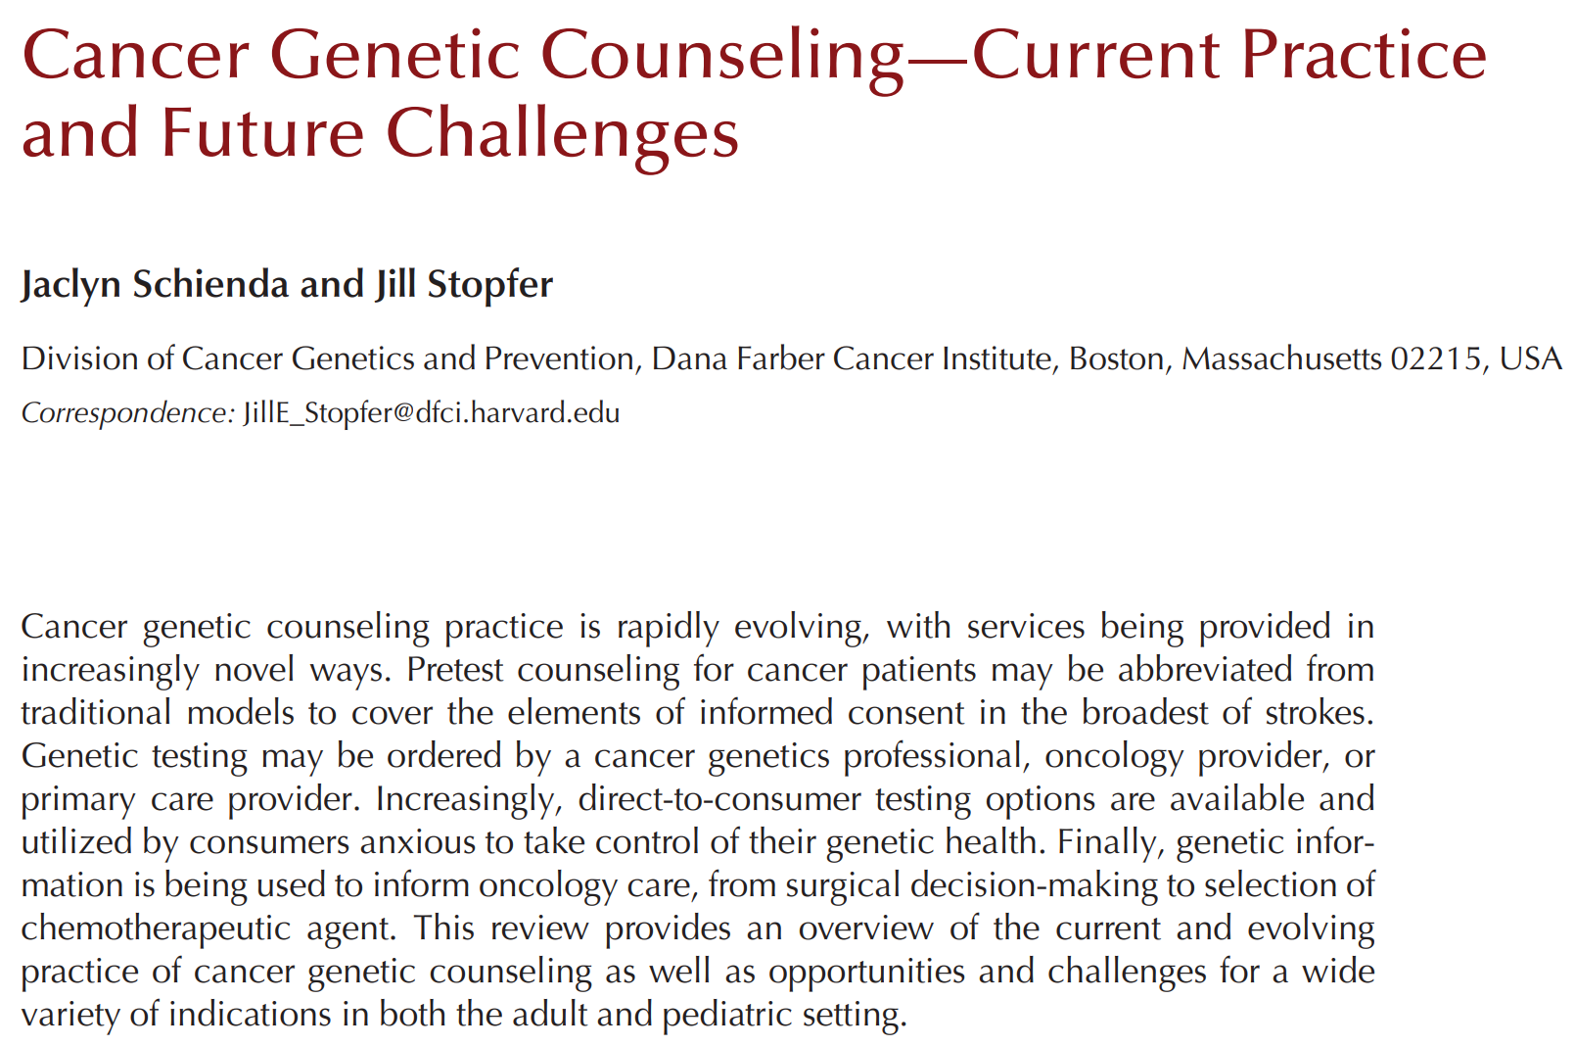

Slide 4
Cancer Genetic Counselling — Current Practice and Future Challenges
CANCER GENETIC COUNSELING — WHERE WE HAVE BEEN AND WHERE WE ARE GOING
WHO IS A CANDIDATE FOR CANCER GENETIC COUNSELING AND TESTING?
THE PROCESS OF CANCER GENETIC COUNSELING
LABORATORY, TEST SELECTION, AND INTERPRETATION ISSUES
SPECIAL ISSUES IN PEDIATRIC ONCOLOGY

Slide 5
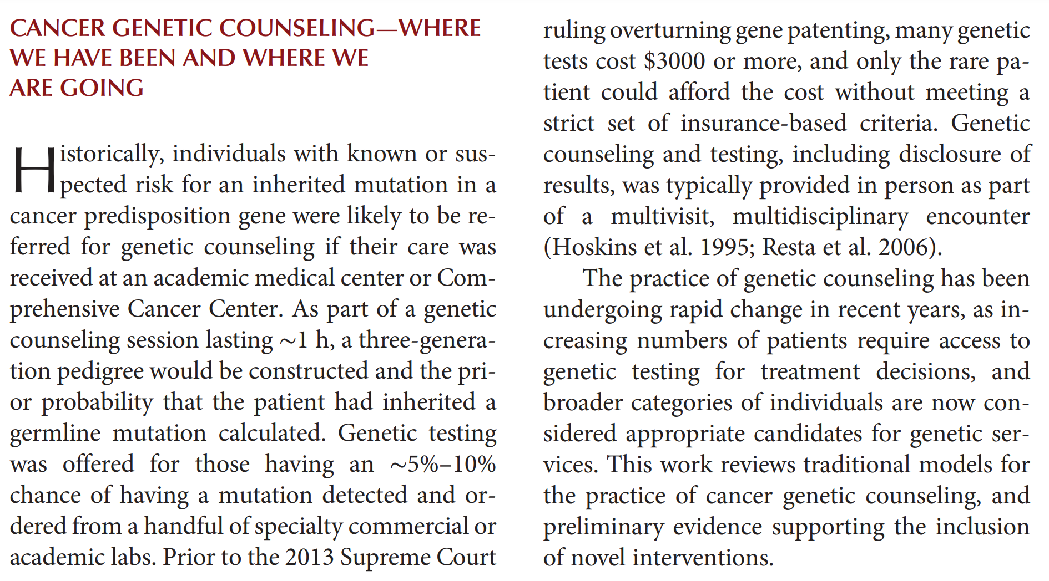
CANCER GENETIC COUNSELING — WHERE WE HAVE BEEN AND WHERE WE ARE GOING

Slide 6
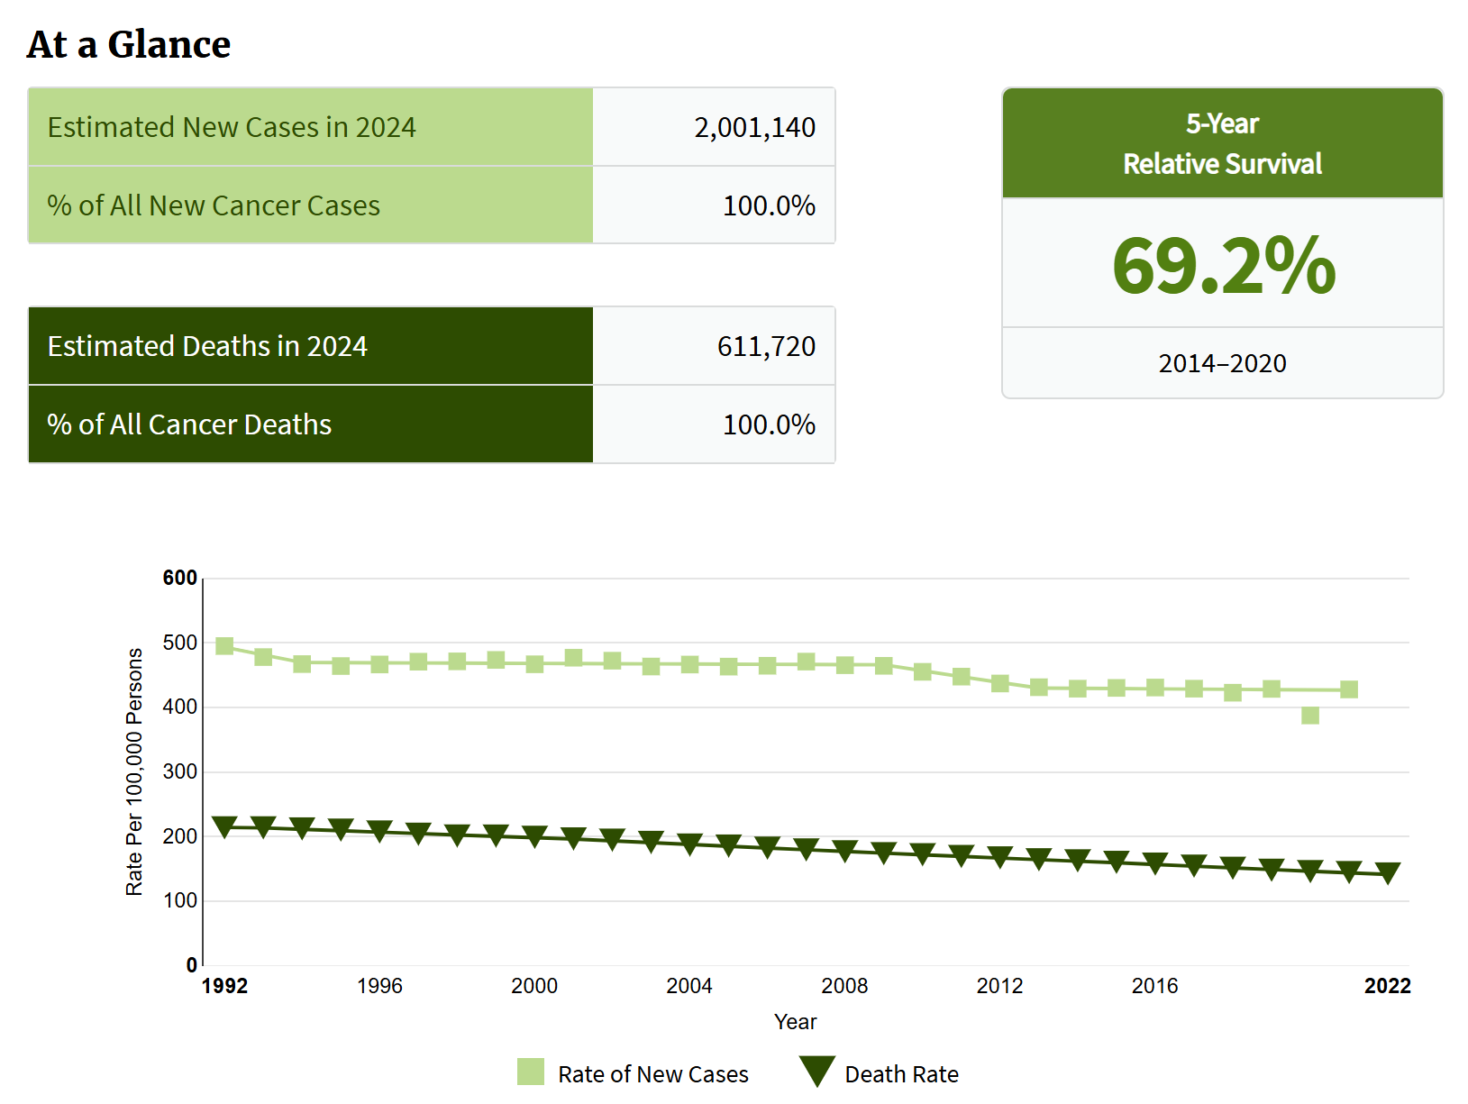
WHO IS A CANDIDATE FOR CANCER GENETIC COUNSELING AND TESTING?
According to SEER estimates from 2014 to 2016, ∼39.3% of men and women will develop cancer in their lifetime, and most will be over the age of 55 year (https://SEER.cancer.gov/statfacts/html/ all.html).
Germline pathogenic variants (PVs) in highly penetrant genes play a major role in at least 5%–10% of all cancers and in more than 50 hereditary cancer syndromes.
https://seer.cancer.gov/statfacts/html/all.html

Slide 7
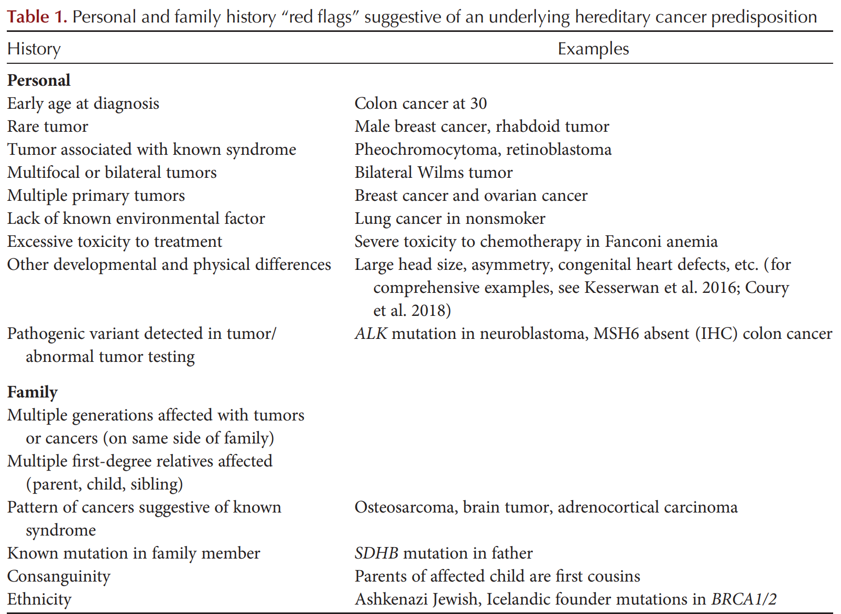
WHO IS A CANDIDATE FOR CANCER GENETIC COUNSELING AND TESTING?

Slide 8
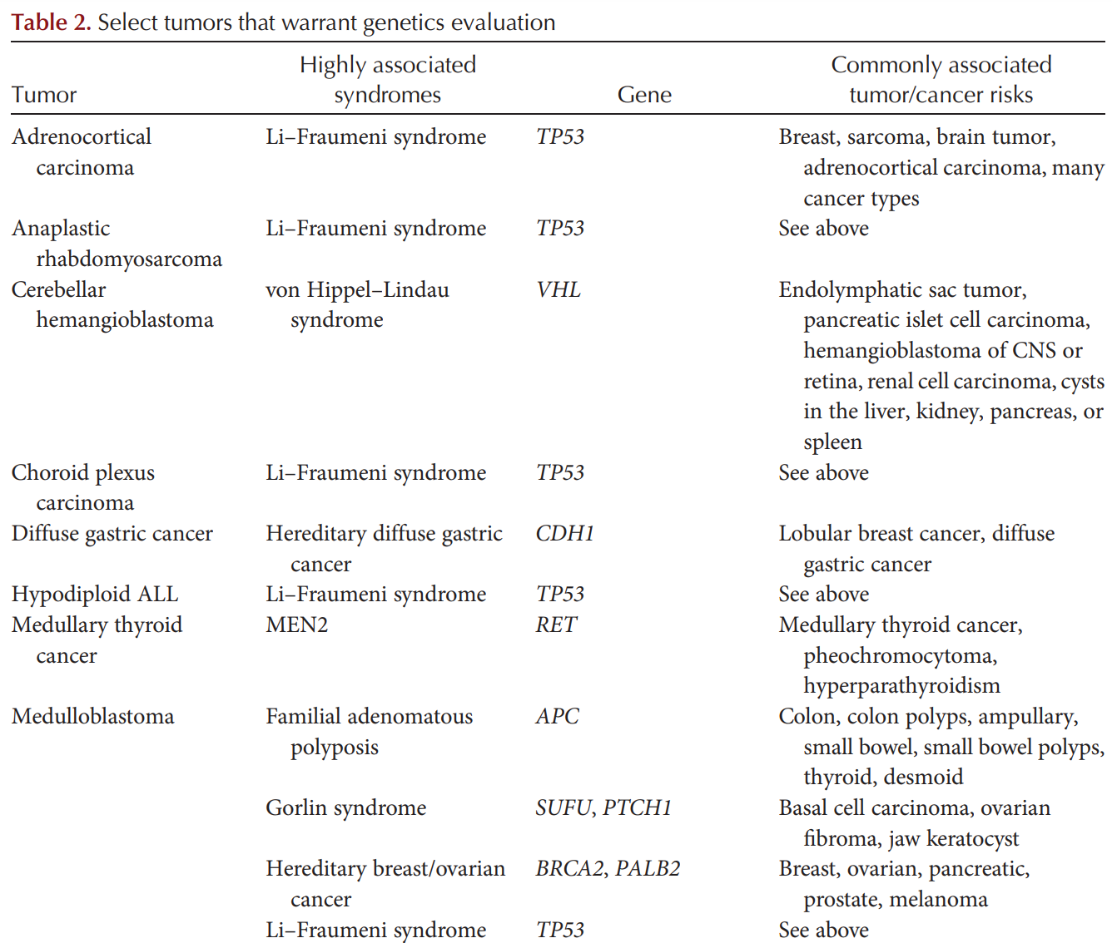
WHO IS A CANDIDATE FOR CANCER GENETIC COUNSELING AND TESTING?

Slide 9
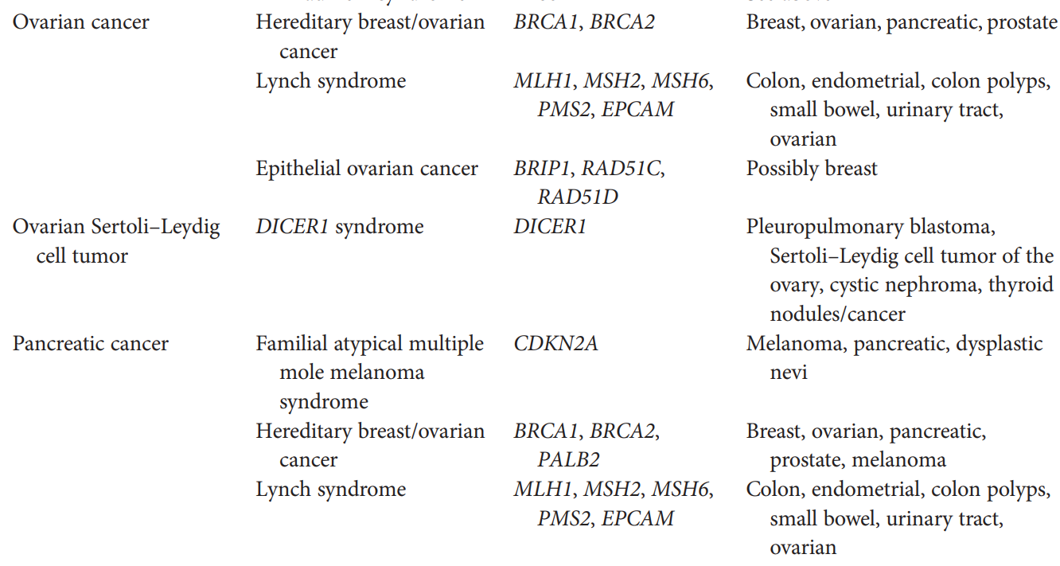
WHO IS A CANDIDATE FOR CANCER GENETIC COUNSELING AND TESTING?

Slide 10
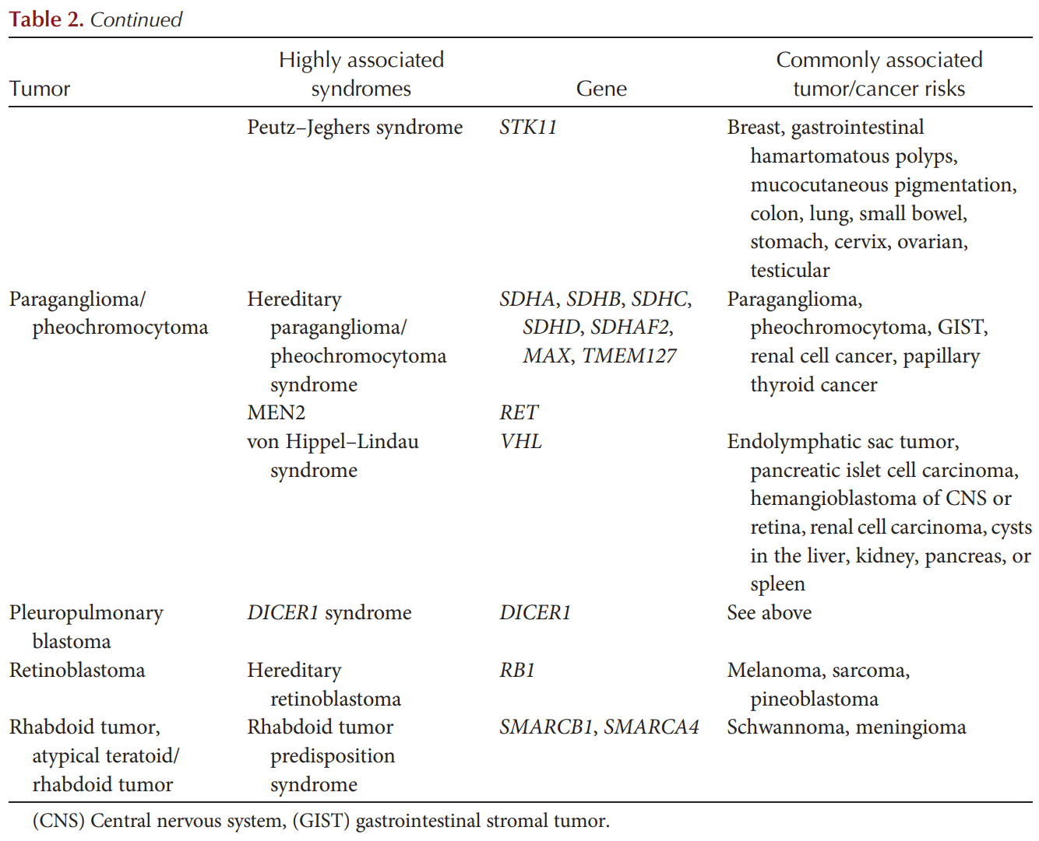
WHO IS A CANDIDATE FOR CANCER GENETIC COUNSELING AND TESTING?

Slide 11
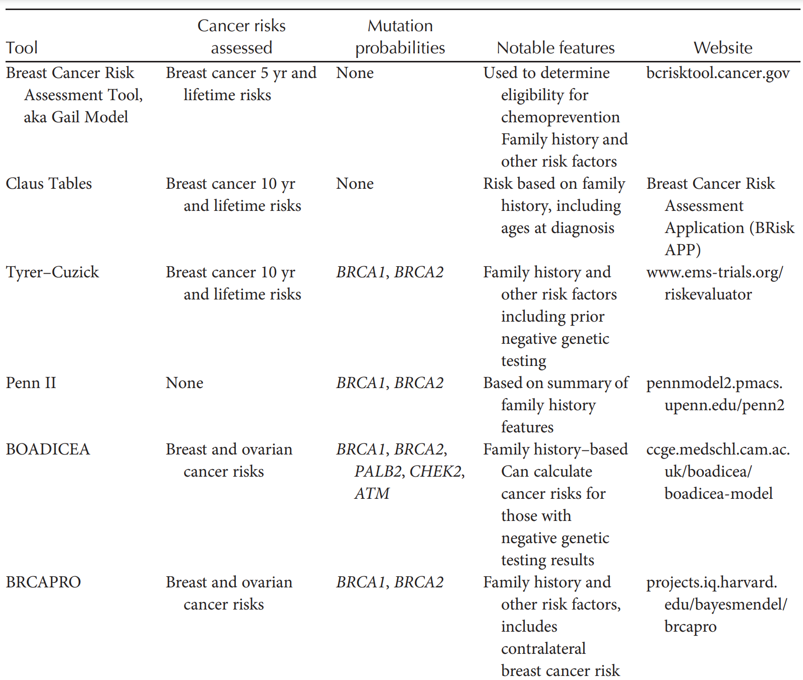
WHO IS A CANDIDATE FOR CANCER GENETIC COUNSELING AND TESTING?

Slide 12
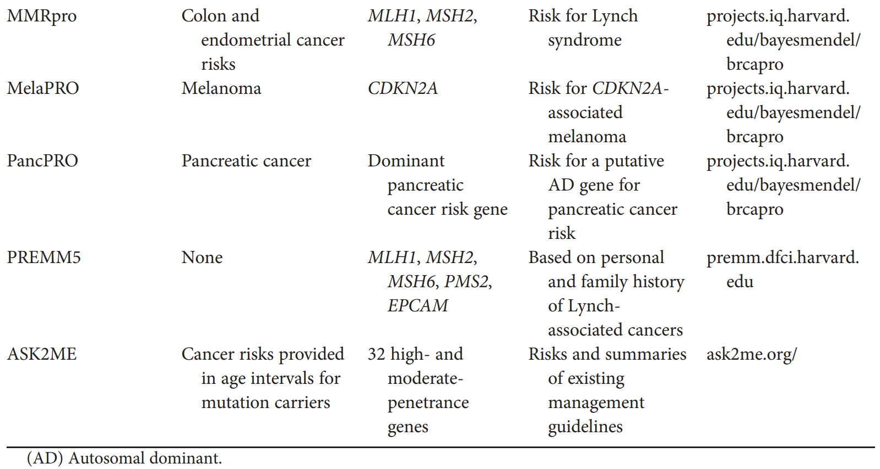
WHO IS A CANDIDATE FOR CANCER GENETIC COUNSELING AND TESTING?

Slide 13
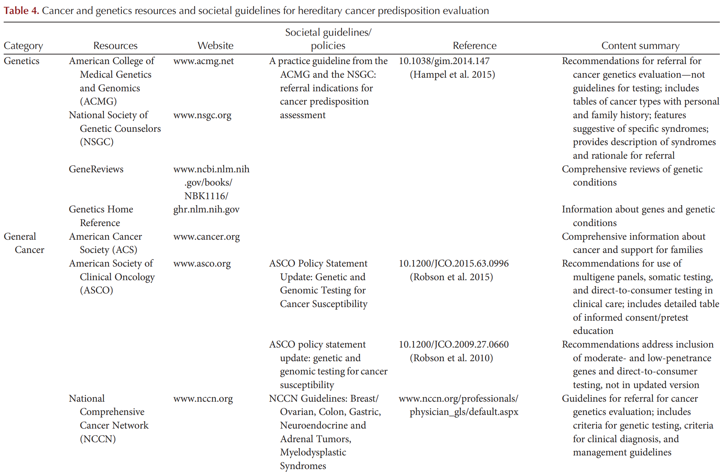
WHO IS A CANDIDATE FOR CANCER GENETIC COUNSELING AND TESTING?

Slide 14
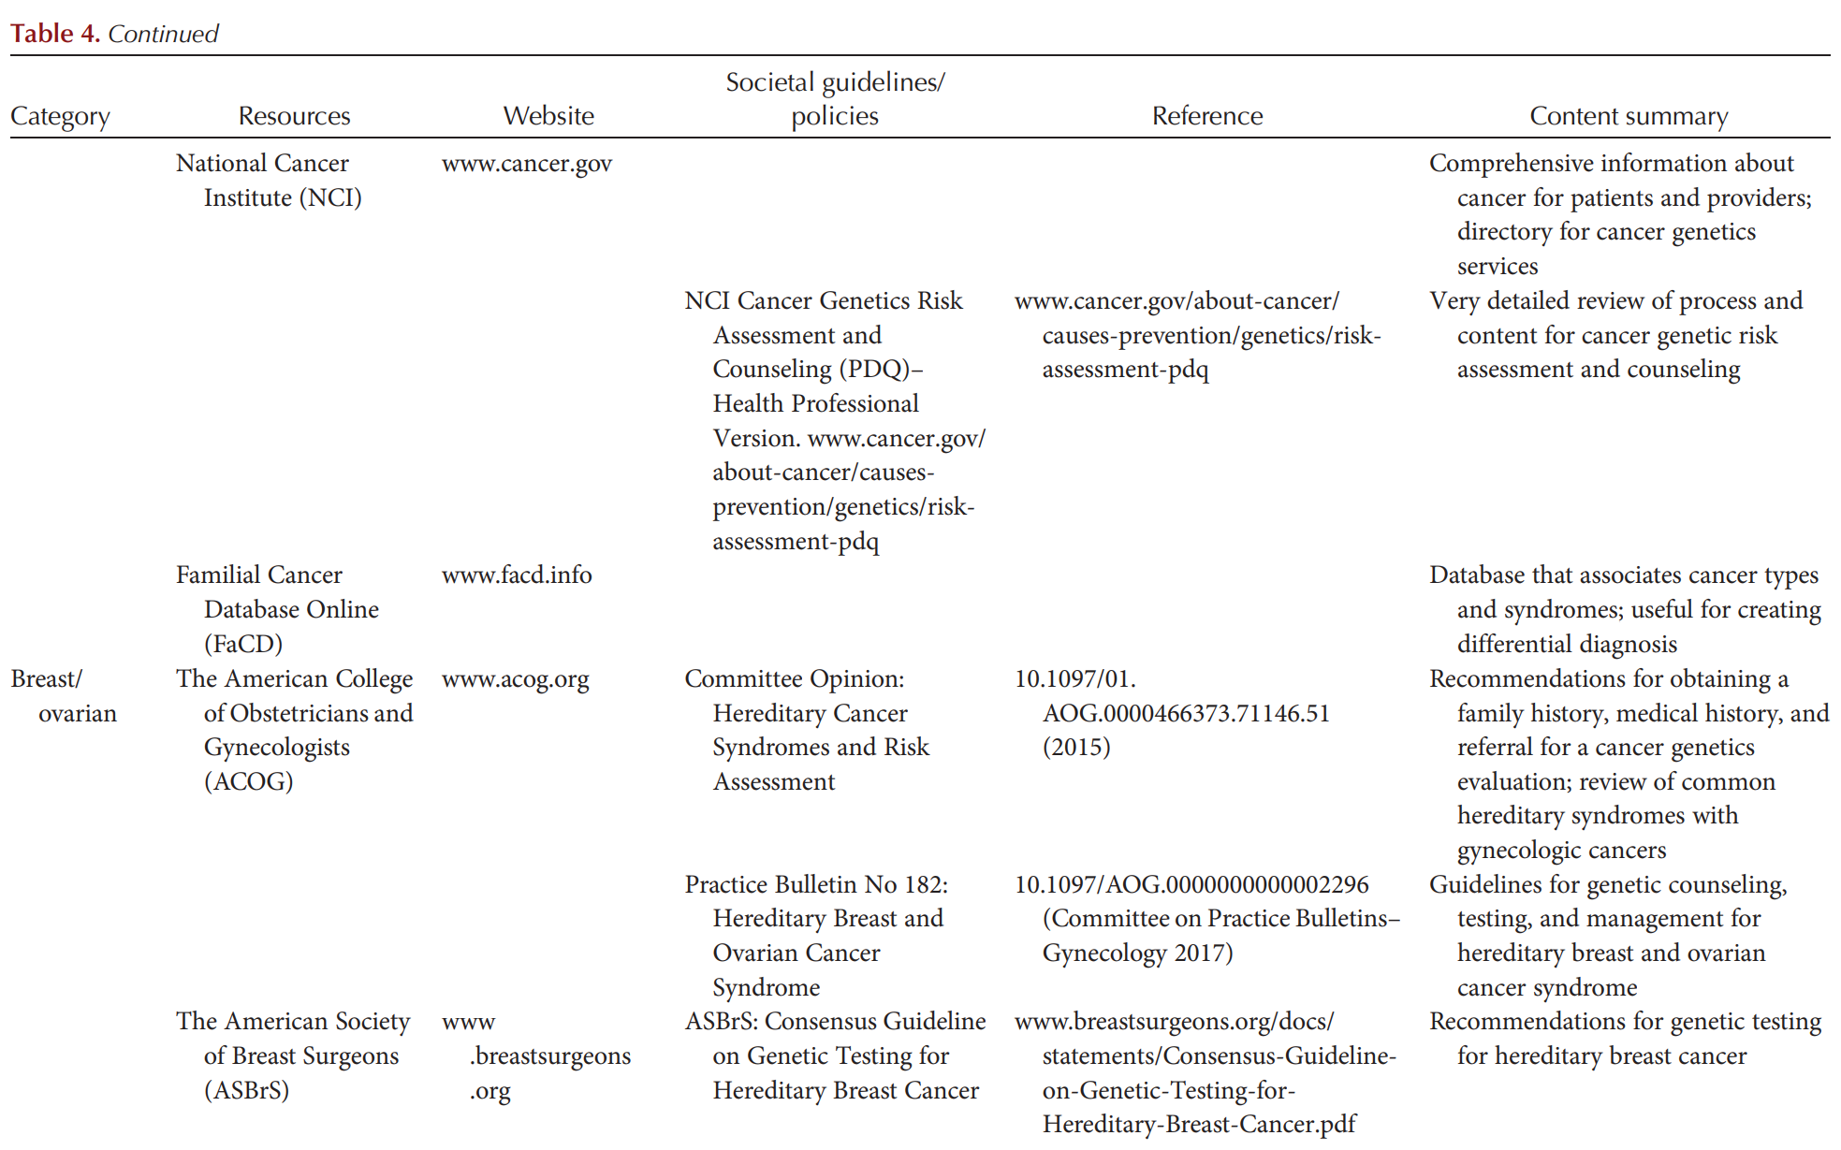
WHO IS A CANDIDATE FOR CANCER GENETIC COUNSELING AND TESTING?

Slide 15
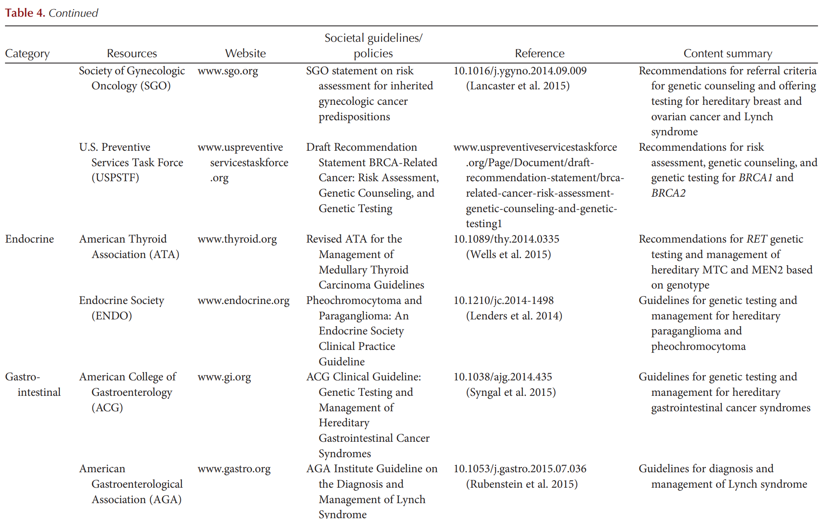
WHO IS A CANDIDATE FOR CANCER GENETIC COUNSELING AND TESTING?

Slide 16
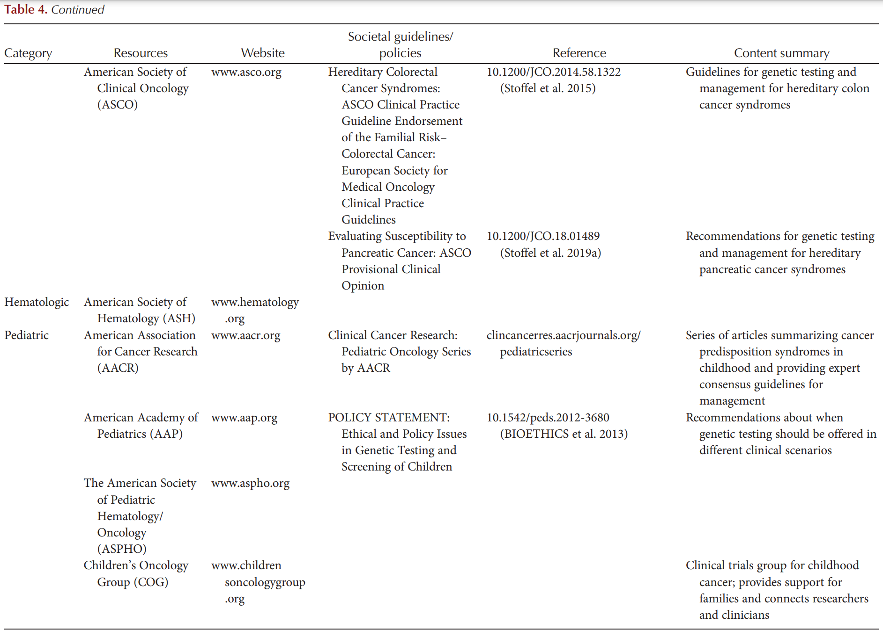
WHO IS A CANDIDATE FOR CANCER GENETIC COUNSELING AND TESTING?

Slide 17
THE PROCESS OF CANCER GENETIC COUNSELING
Genetic counseling is “the process of helping people understand and adapt to the medical, psychological, and familial implications of genetic contributions to disease” (Resta et al. 2006).
Genetic counseling was proposed as a key component of the cancer risk assessment process in the 1990s (Peters and Stopfer 1996; Stopfer 2000)
Empowering patients to make informed decisions regarding
screening,
prevention, and
genetic testing through provision of pertinent genetic and medical information and tailored psychological counseling remain core goals

Slide 18
THE PROCESS OF CANCER GENETIC COUNSELING
The Cancer Genetics Studies Consortium (CSGC) Task Force was among the first groups in the oncology setting to develop consensus guidelines for the process and content of informed consent (Geller et al. 1997).
This multidisciplinary group first considered why informed consent for genetic testing requires special consideration and acknowledged the following issues:
(1) Genetic information affects an entire family,
(2) genetic information can present unique challenges for medical professionals as it is probabilistic in nature, and
(3) genetic information can lead to the reclassification of patients from healthy to high risk.
At that time, the authors described the primary risks and benefits as psychological and social rather than physical or medical because the efficacy of preventive and therapeutic strategies in PV carriers had not yet been substantiated.

Slide 19
THE PROCESS OF CANCER GENETIC COUNSELING
The Cancer Genetics Studies Consortium (CSGC) Task Force was among the first groups in the oncology setting to develop consensus guidelines for the process and content of informed consent (Geller et al. 1997).
This multidisciplinary group first considered why informed consent for genetic testing requires special consideration and acknowledged the following issues:
(1) Genetic information affects an entire family,
(2) genetic information can present unique challenges for medical professionals as it is probabilistic in nature, and
(3) genetic information can lead to the reclassification of patients from healthy to high risk.
At that time, the authors described the primary risks and benefits as psychological and social rather than physical or medical because the efficacy of preventive and therapeutic strategies in PV carriers had not yet been substantiated.

Slide 20
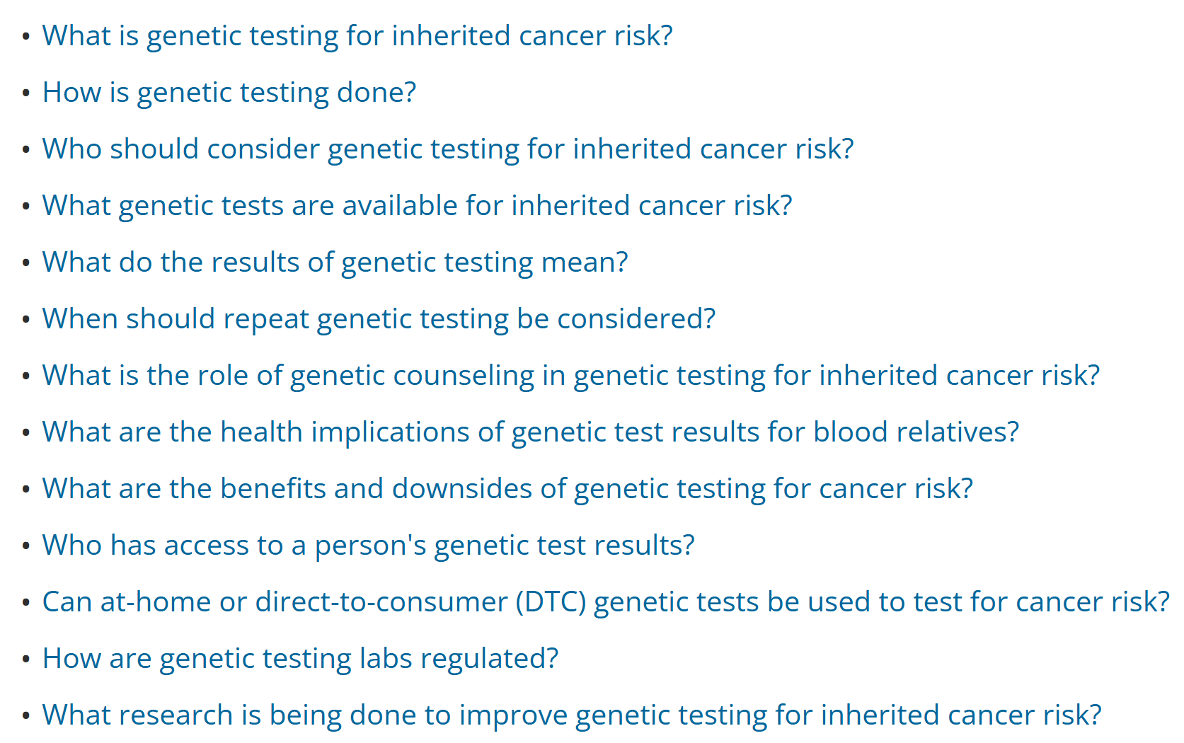
Genetic Testing for Inherited Cancer Risk
https://www.cancer.gov/about-cancer/causes-prevention/genetics/genetic-testing-fact-sheet

Slide 21
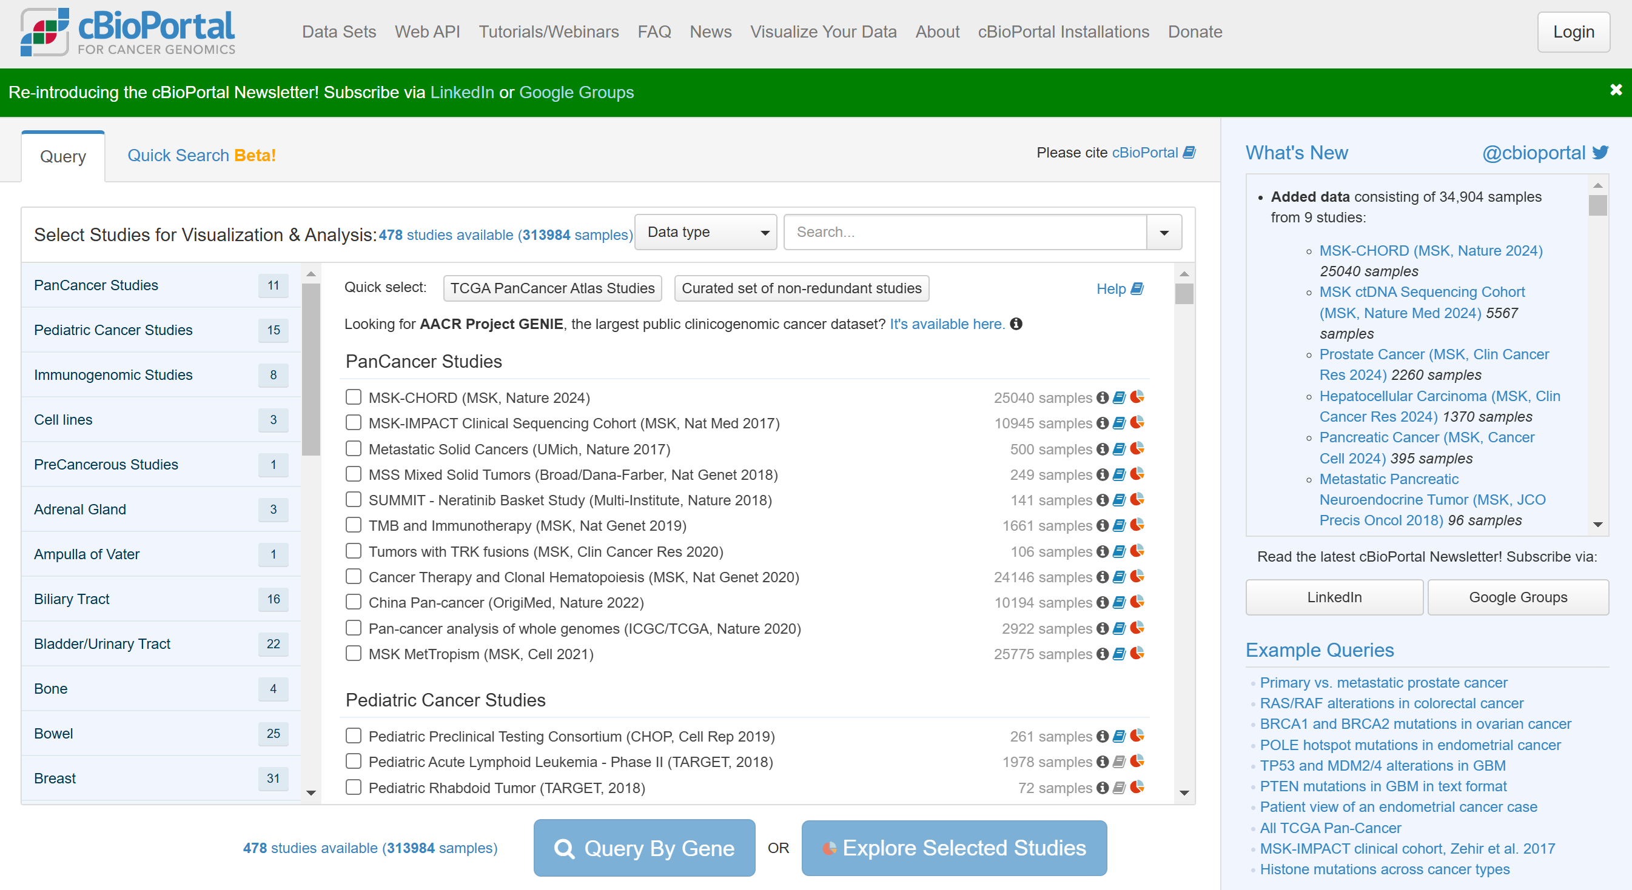
cbioportal.org
https://www.cbioportal.org/

Slide 22
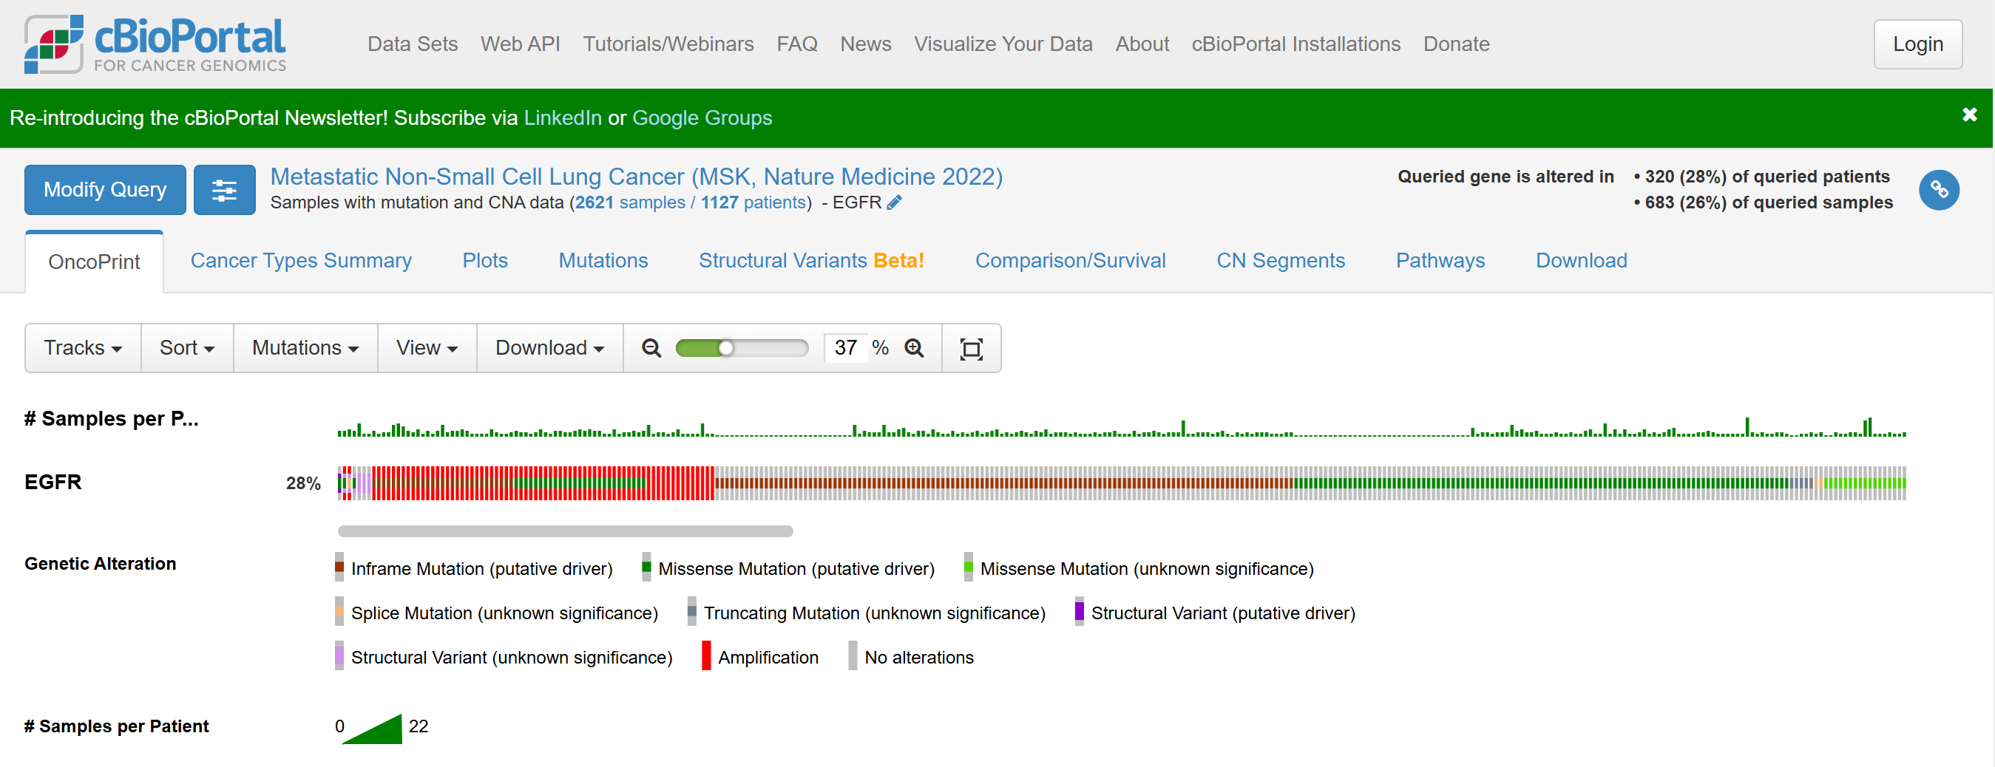
Lung cancer: EGFR
https://www.cbioportal.org/results/oncoprint?cancer_study_list=nsclc_ctdx_msk_2022&Z_SCORE_THRESHOLD=2.0&RPPA_SCORE_THRESHOLD=2.0&profileFilter=mutations%2Cstructural_variants%2Ccna&case_set_id=nsclc_ctdx_msk_2022_cnaseq&gene_list=EGFR&geneset_list=%20&tab_index=tab_visualize&Action=Submit

Slide 23
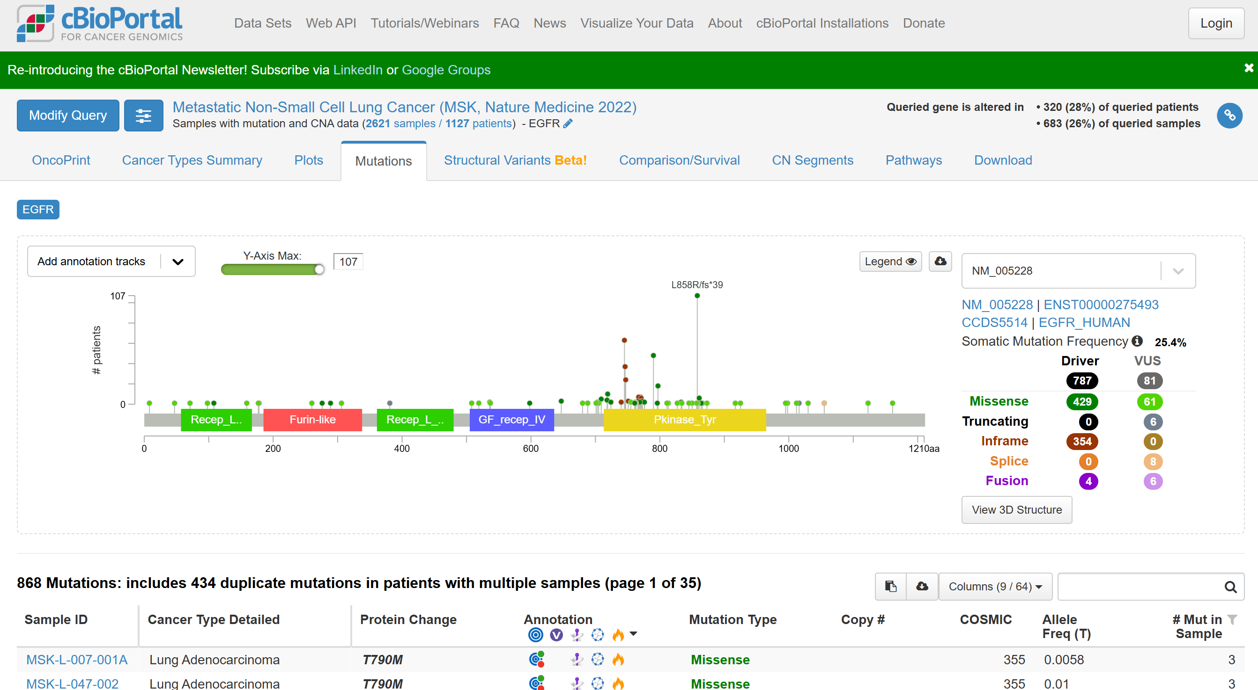
Lung cancer: EGFR
https://www.cbioportal.org/results/mutations?cancer_study_list=nsclc_ctdx_msk_2022&Z_SCORE_THRESHOLD=2.0&RPPA_SCORE_THRESHOLD=2.0&profileFilter=mutations%2Cstructural_variants%2Ccna&case_set_id=nsclc_ctdx_msk_2022_cnaseq&gene_list=EGFR&geneset_list=%20&tab_index=tab_visualize&Action=Submit

Slide 24
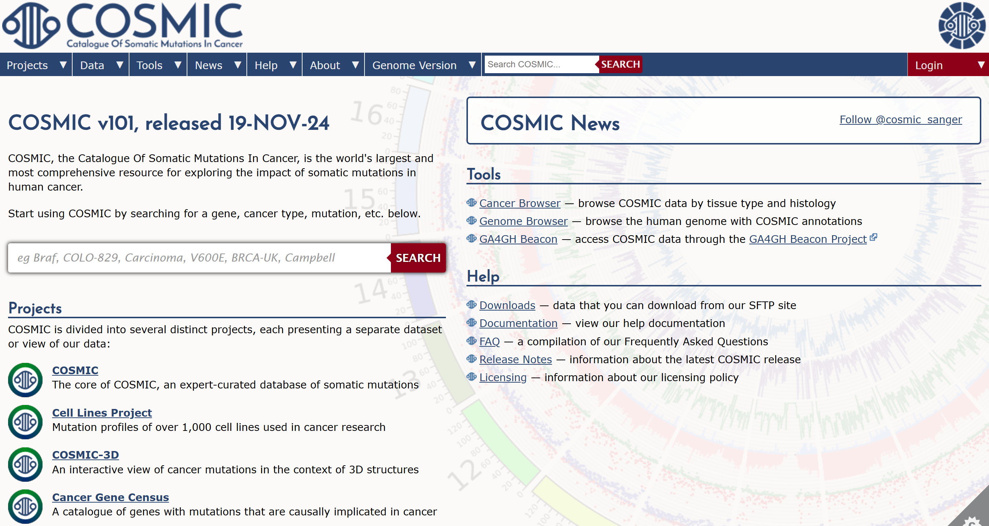
COSMIC (https://cancer.sanger.ac.uk/cosmic)
https://cancer.sanger.ac.uk/cosmic

Slide 25
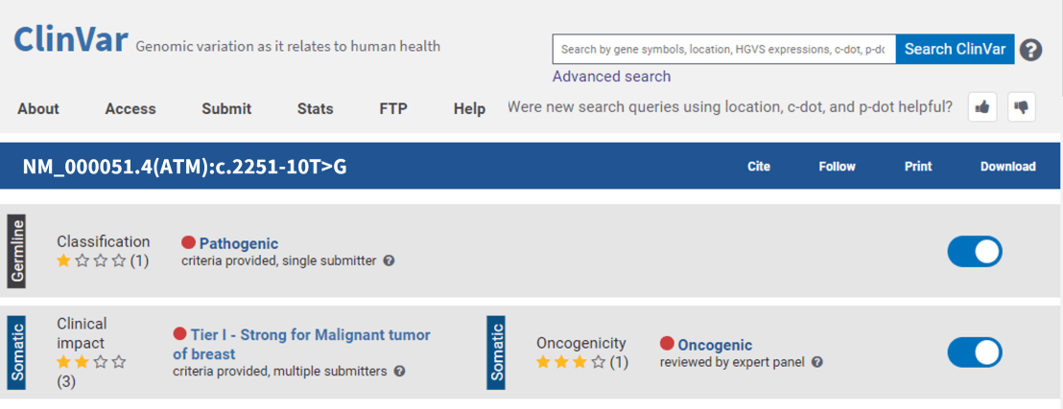
Clinvar (https://www.ncbi.nlm.nih.gov/clinvar)

Slide 26
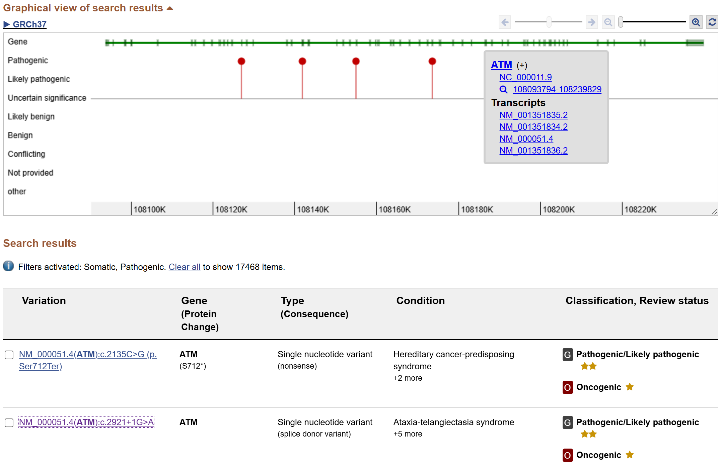
Clinvar (https://www.ncbi.nlm.nih.gov/clinvar)

Slide 27
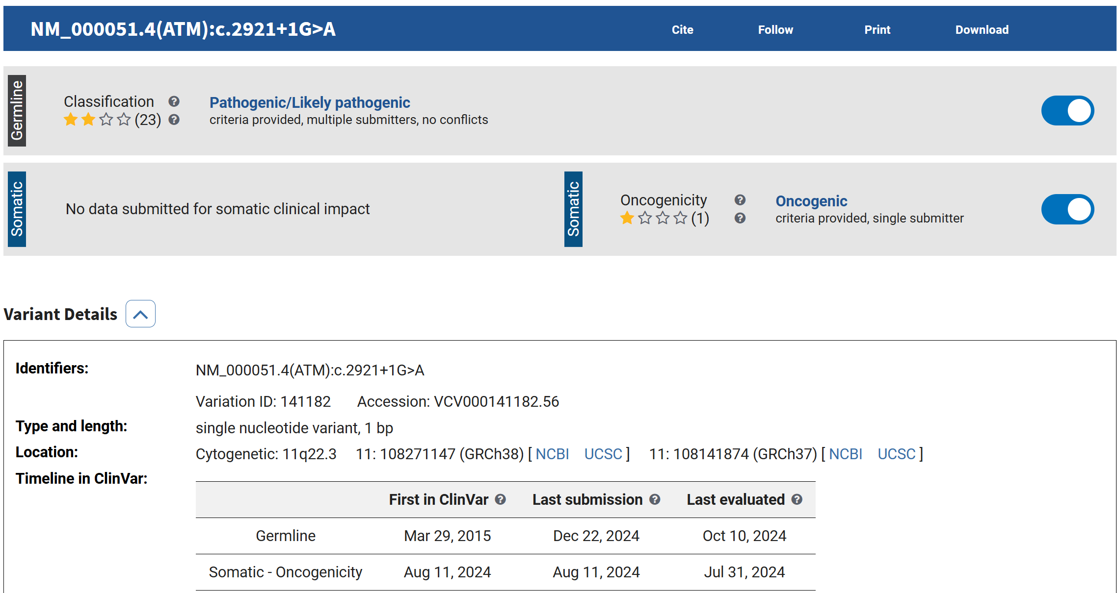
Clinvar: NM_000051.4(ATM):c.2921+1G>A
https://www.ncbi.nlm.nih.gov/clinvar/variation/141182/

Slide 28
Xin chân thành cảm ơn!
Luu Phuc Loi, PhD
Zalo: 0901802182
Email: luu.p.loi@googlemail.com

